Slide 1

It’s Me Parrot Rakhy

Slide 2
basic sys Python + DBMS machine learning data science web development video editing ai expert tools network access

Slide 3
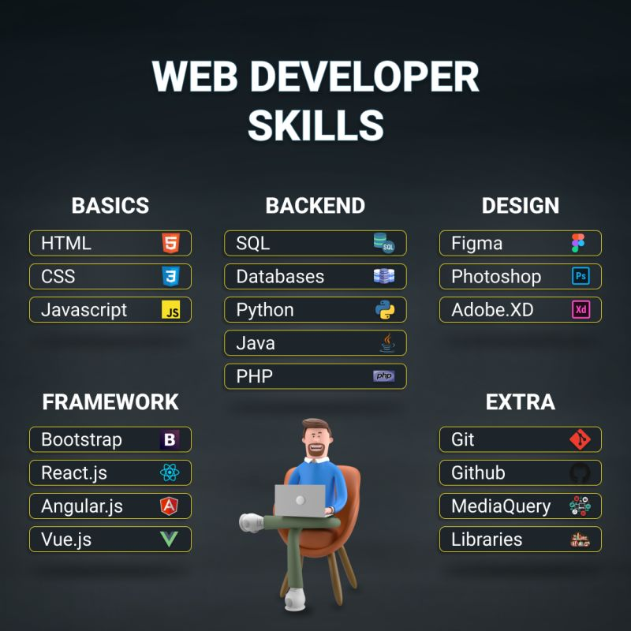

Slide 4
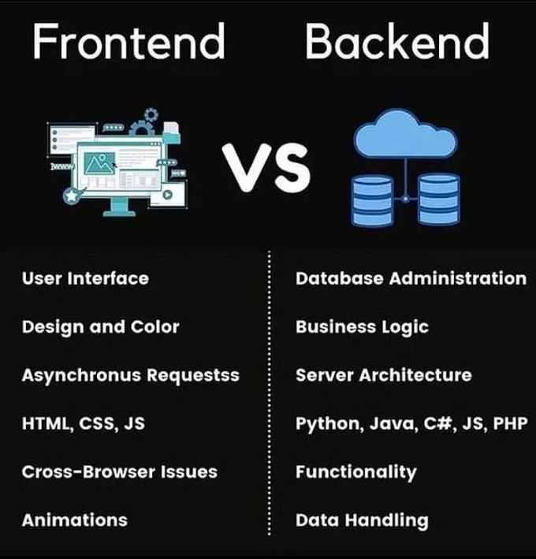

Slide 5
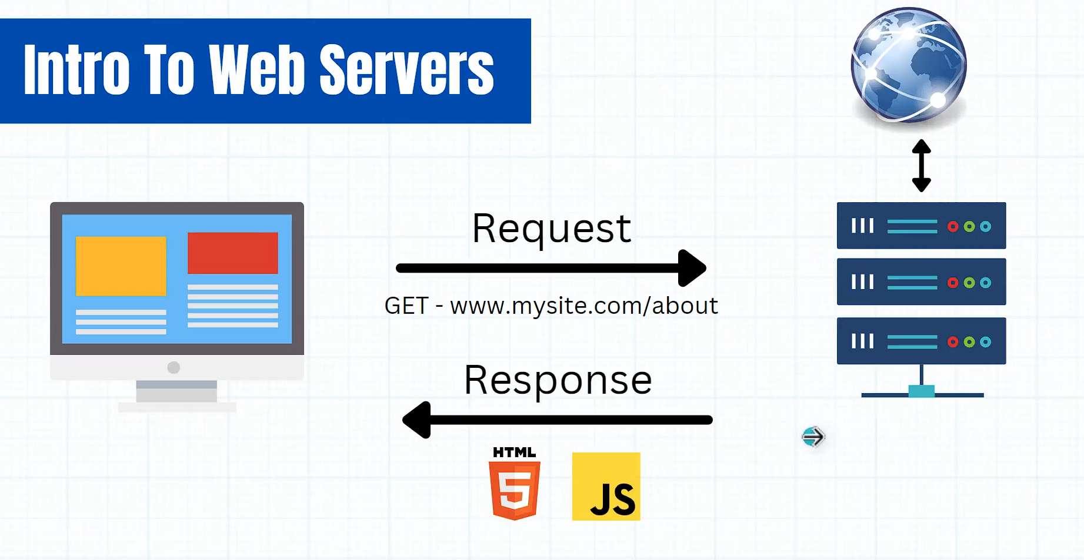

Slide 6
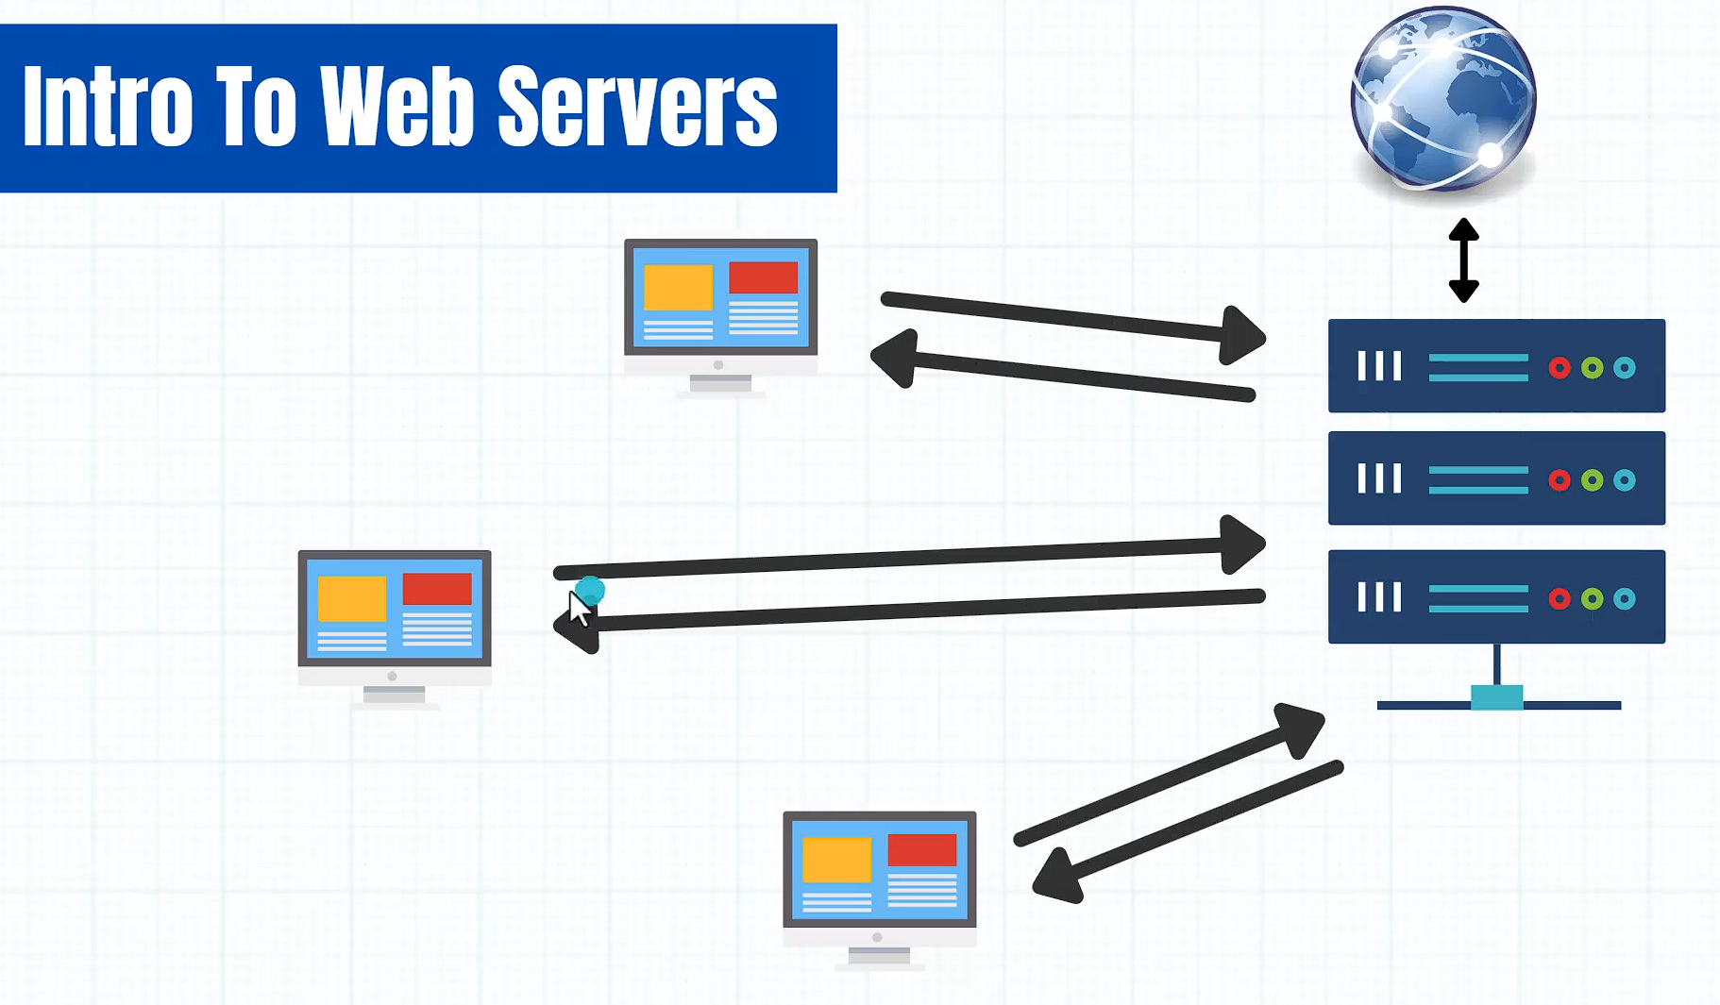

Slide 7
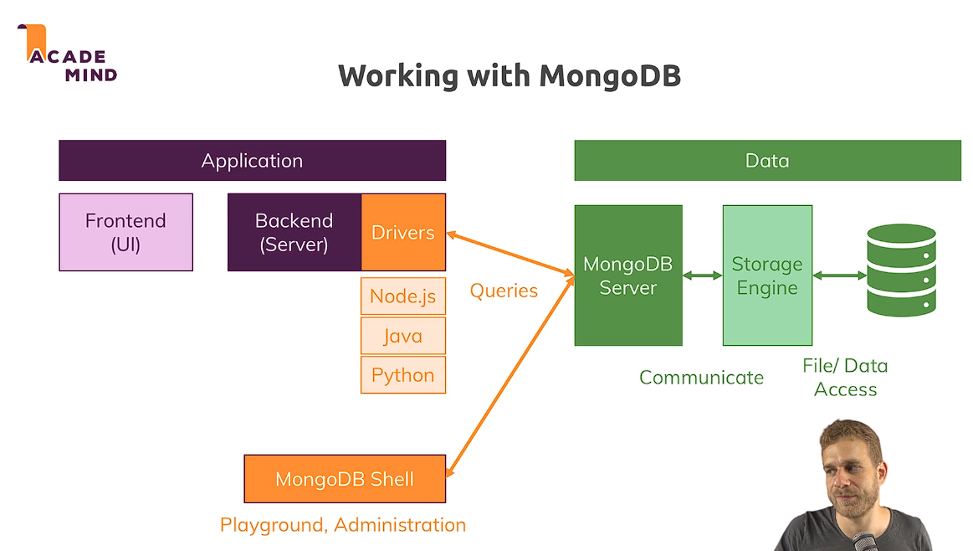

Slide 8
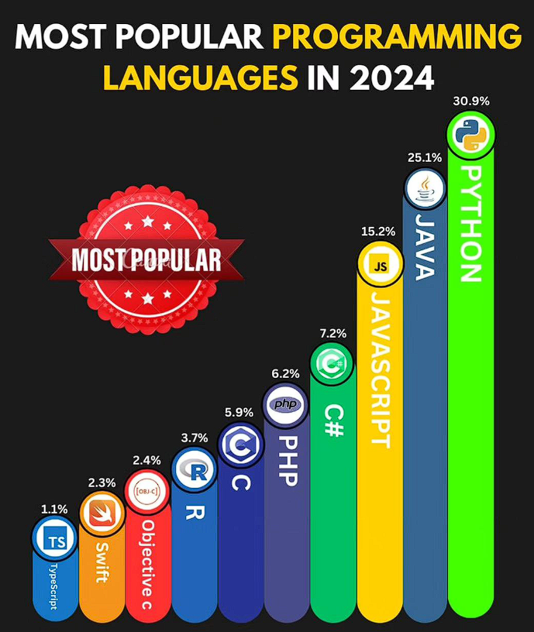

Slide 9
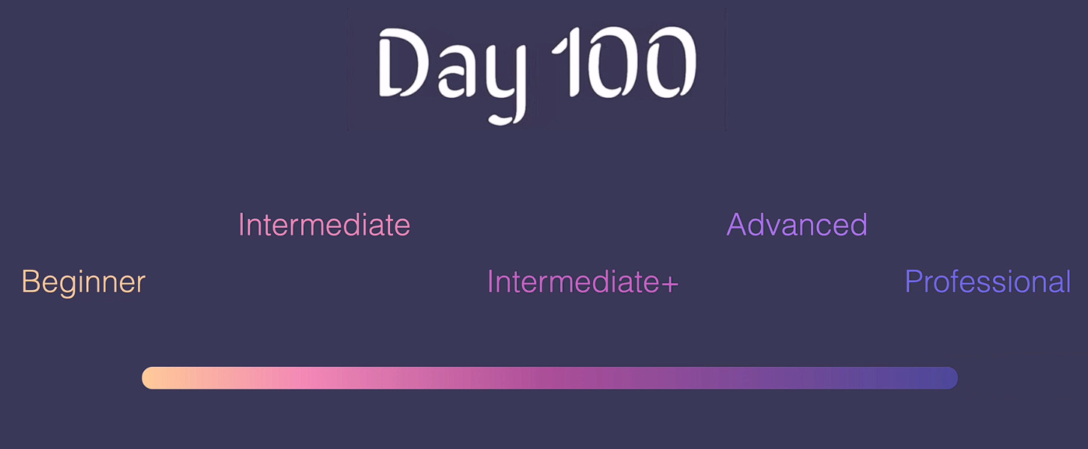

Slide 10
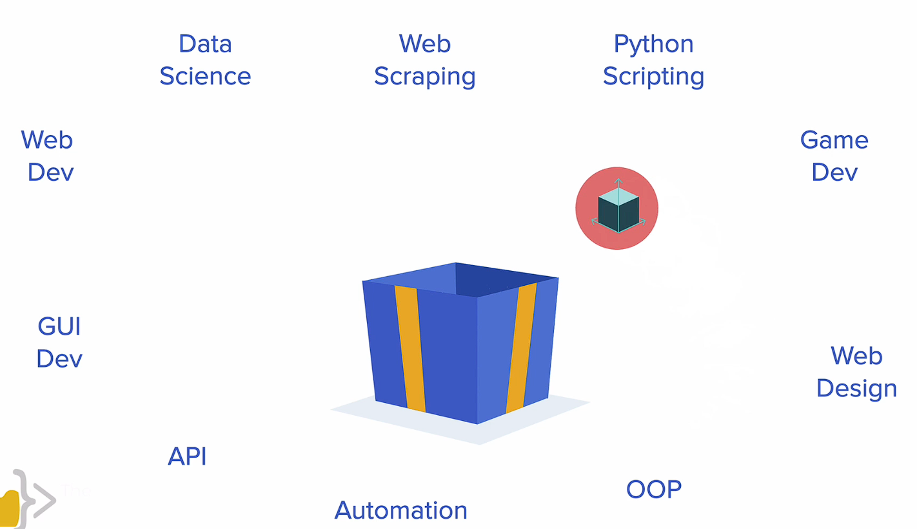

Slide 11
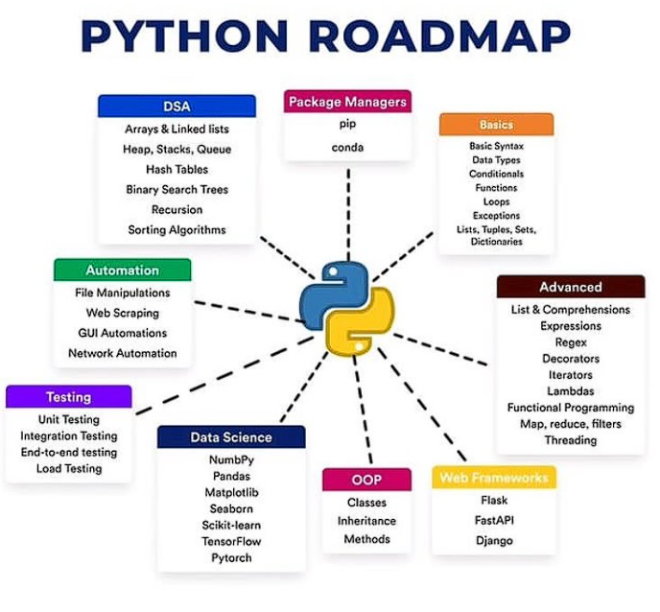

Slide 12
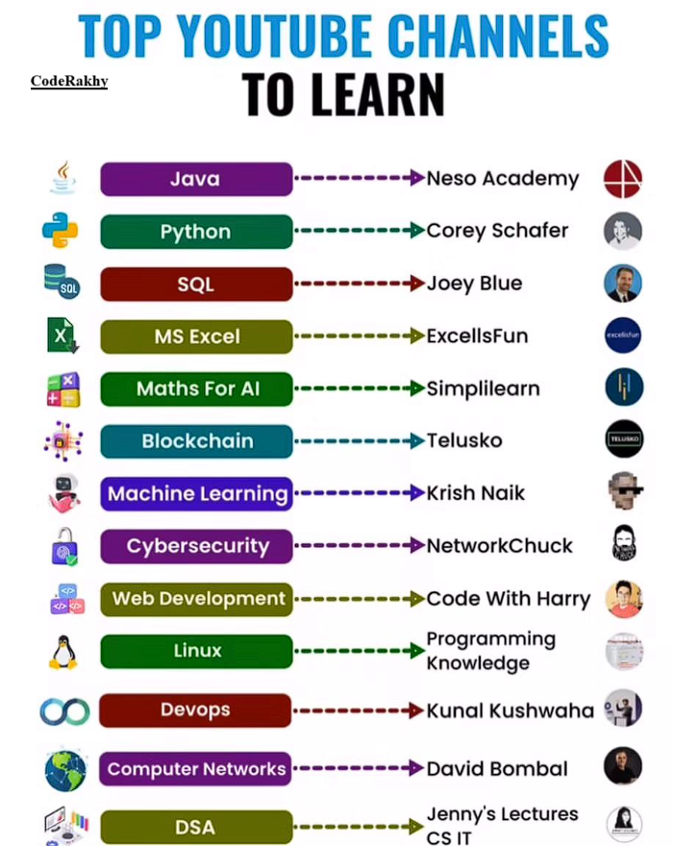

Slide 13
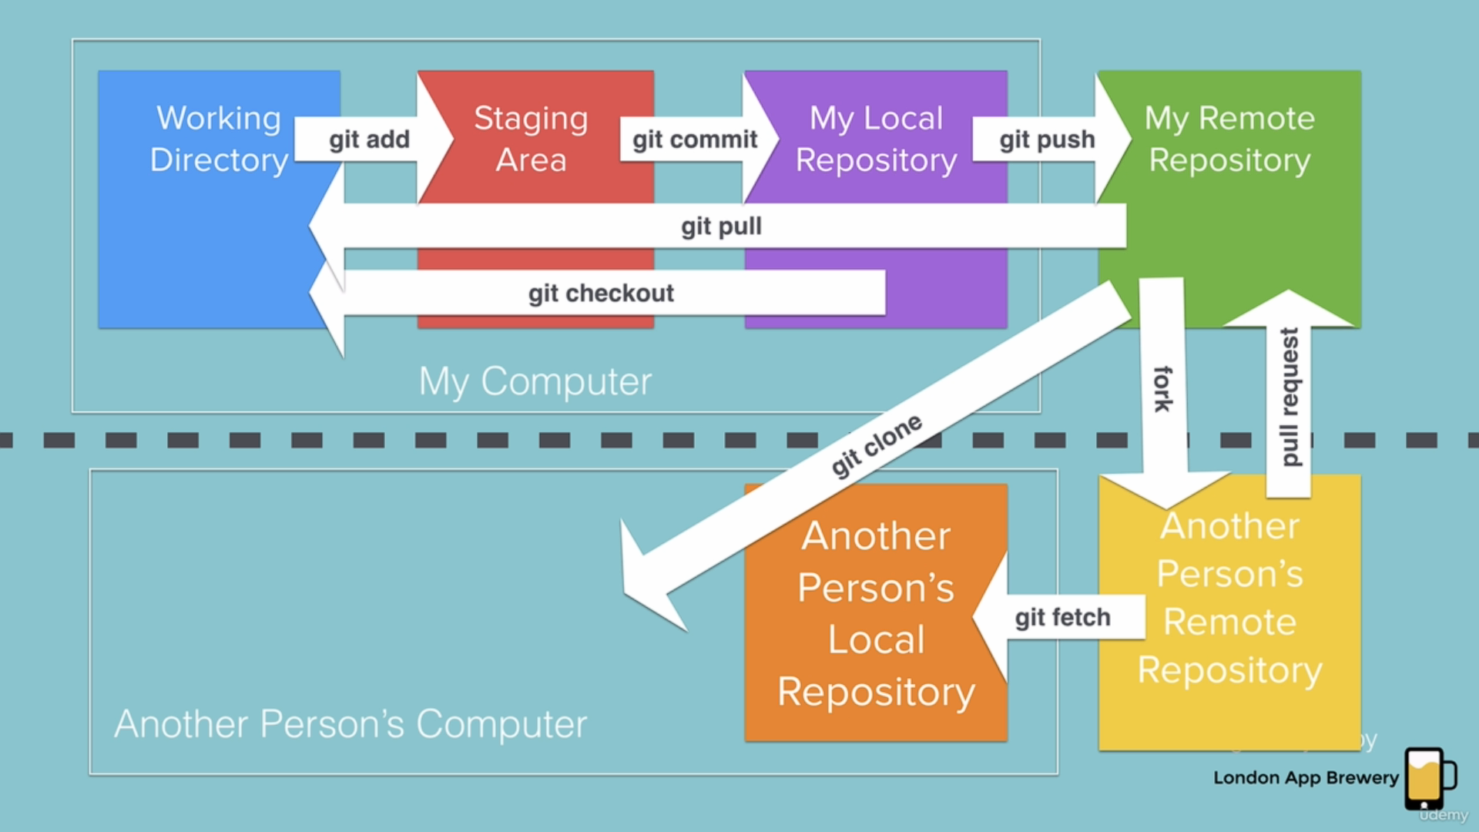
Git Commands

Slide 14
Ai tools

Slide 15


Slide 16


Slide 17
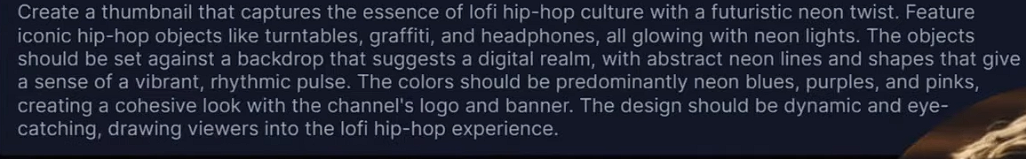
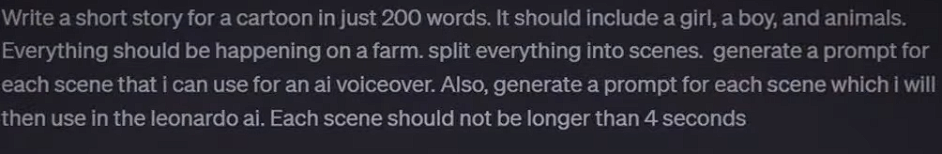
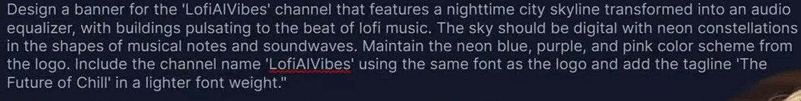
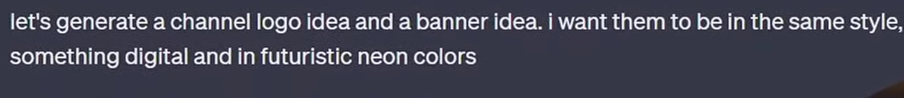
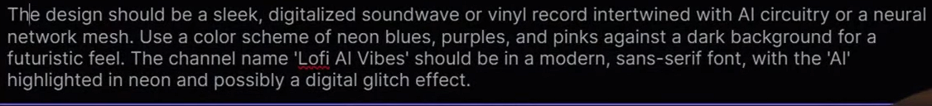
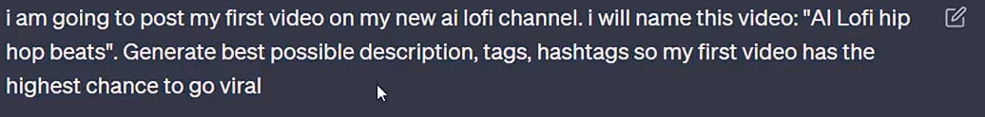

Slide 18
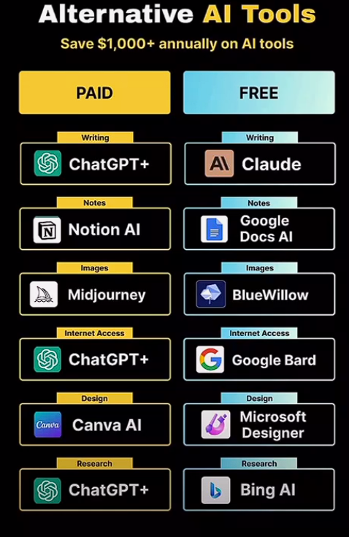

Slide 19
Tips & Tricks
Fake Emails
VPN security
Sharing Screens
Storing Data -- like Clouds
Searching Anyonmsoly – Tor Browser
Latest Updates related to AI and Stock or Financial related info etc. ( YT / Google)
Starting Your Business / YT Channel

Slide 20

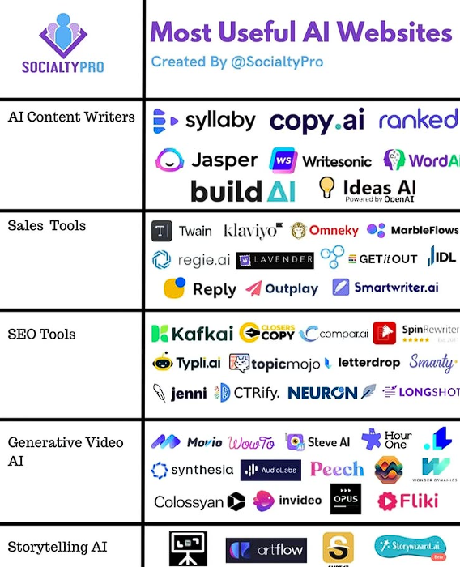
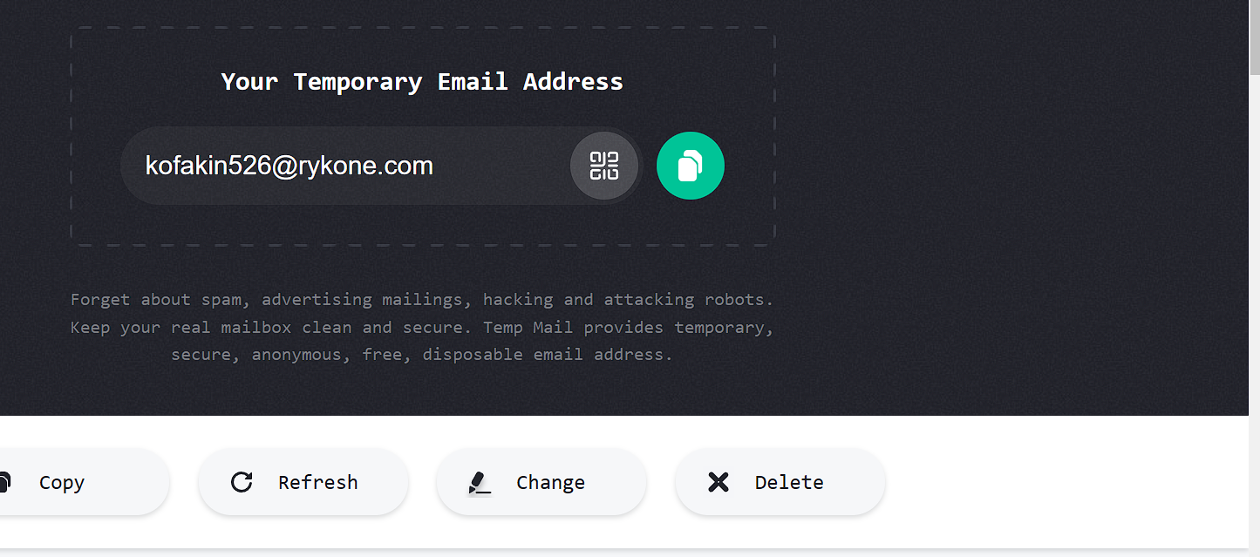





Slide 21
Resource links
If you feel like practicing your Python skills, check out these websites: https://codewars.com/
https://exercism.org/
https://leetcode.com/
https://hackerrank.com/
https://py.checkio.org/
https://www.codingame.com/

Slide 22
END

Slide 23
AI Tools
Day 1 – chatgpt ( ask anything you want)
Day 2 – suno.ai ( for music)
Day 3 -- lenoardo.ai ( for Image generating)
Day 4 – gamma.app ( for ppt presentations using AI)

Slide 24
Network & privacy tricks
Temporay Emails --- https://temp-mail.org/en/
Check your email is secure ---- https://haveibeenpwned.com/
typing test ---- https://keybr.com

Slide 25
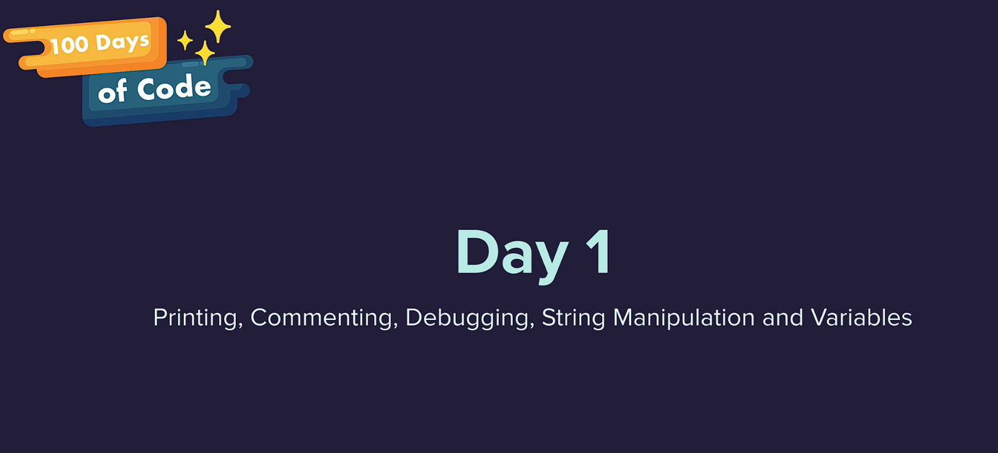

Slide 26
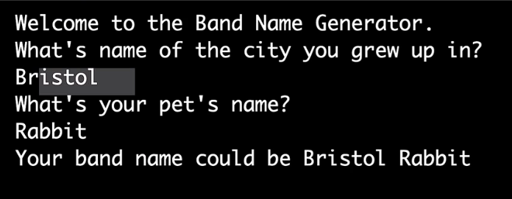
Day – 1 Project

Slide 27
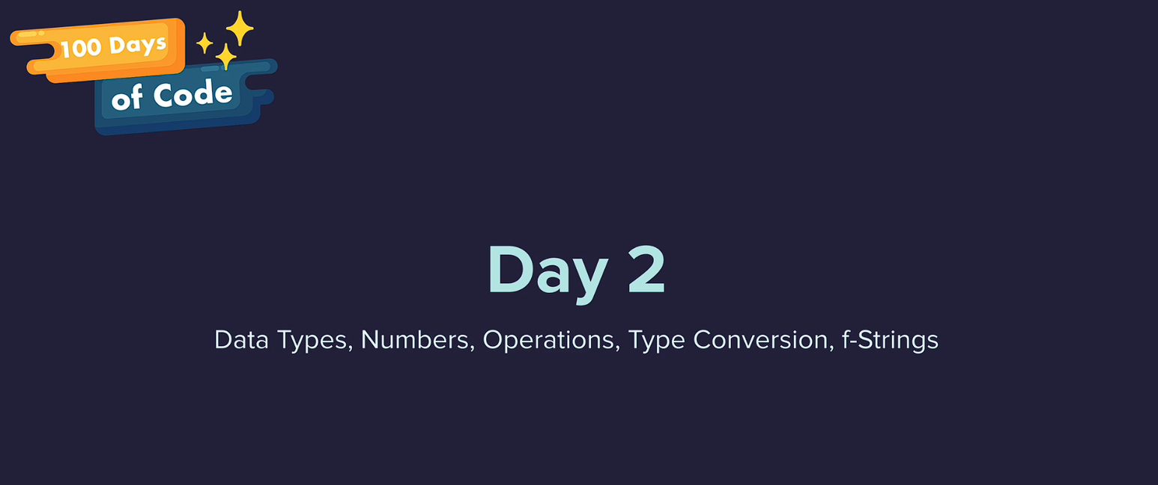

Slide 28
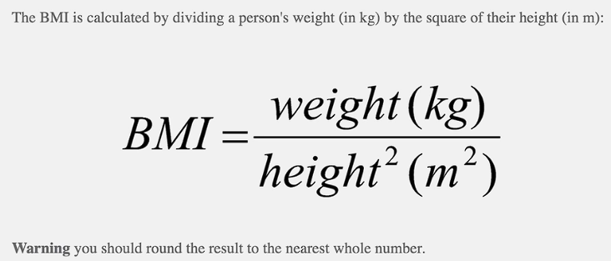
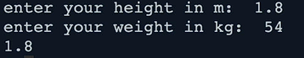
task

Slide 29
Task

Slide 30
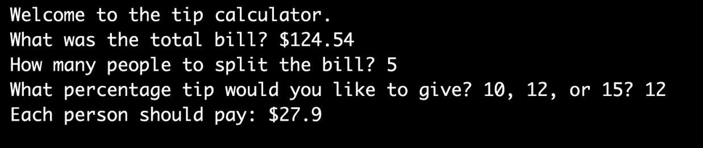
Day – 2 Project

Slide 31
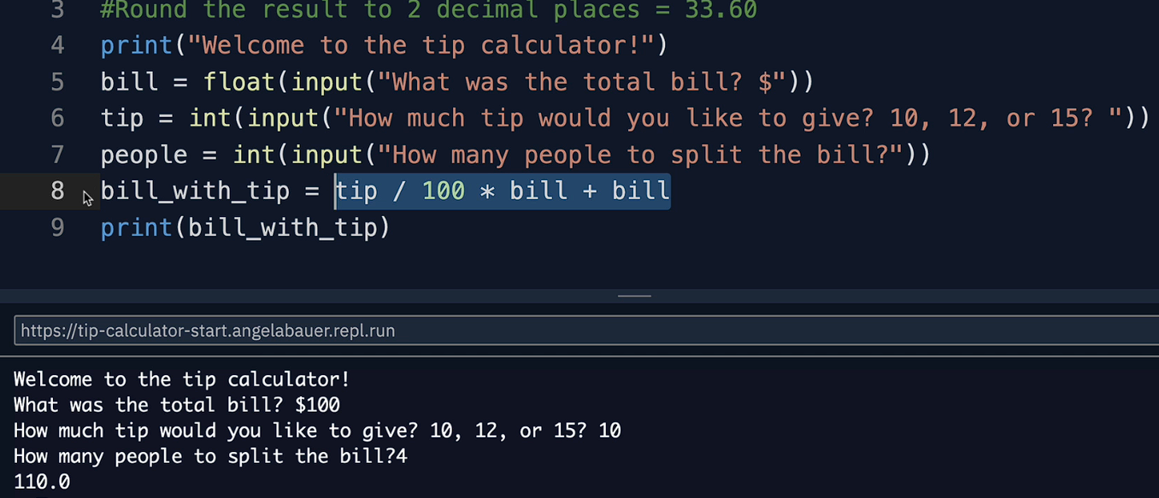
Solution

Slide 32
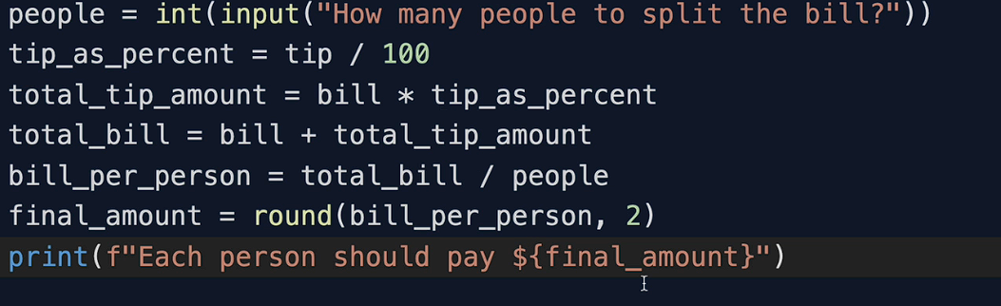
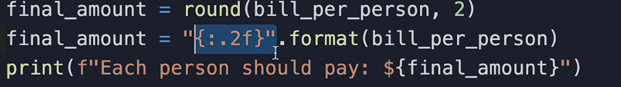
Another way solution - project 2

Slide 33


Slide 34

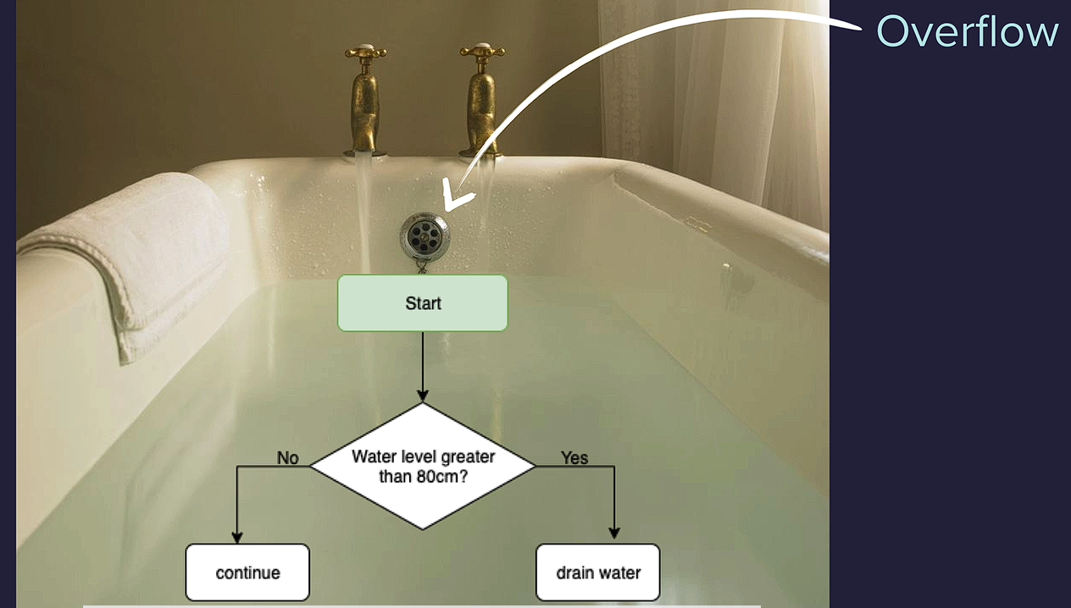
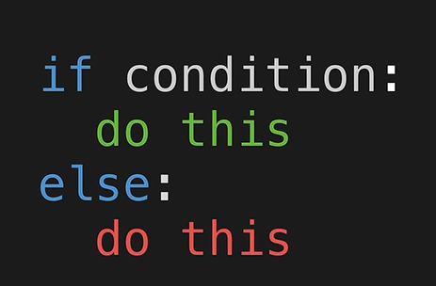

Slide 35
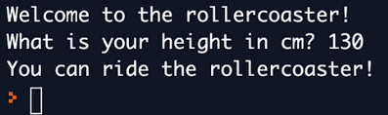
Task

Slide 36
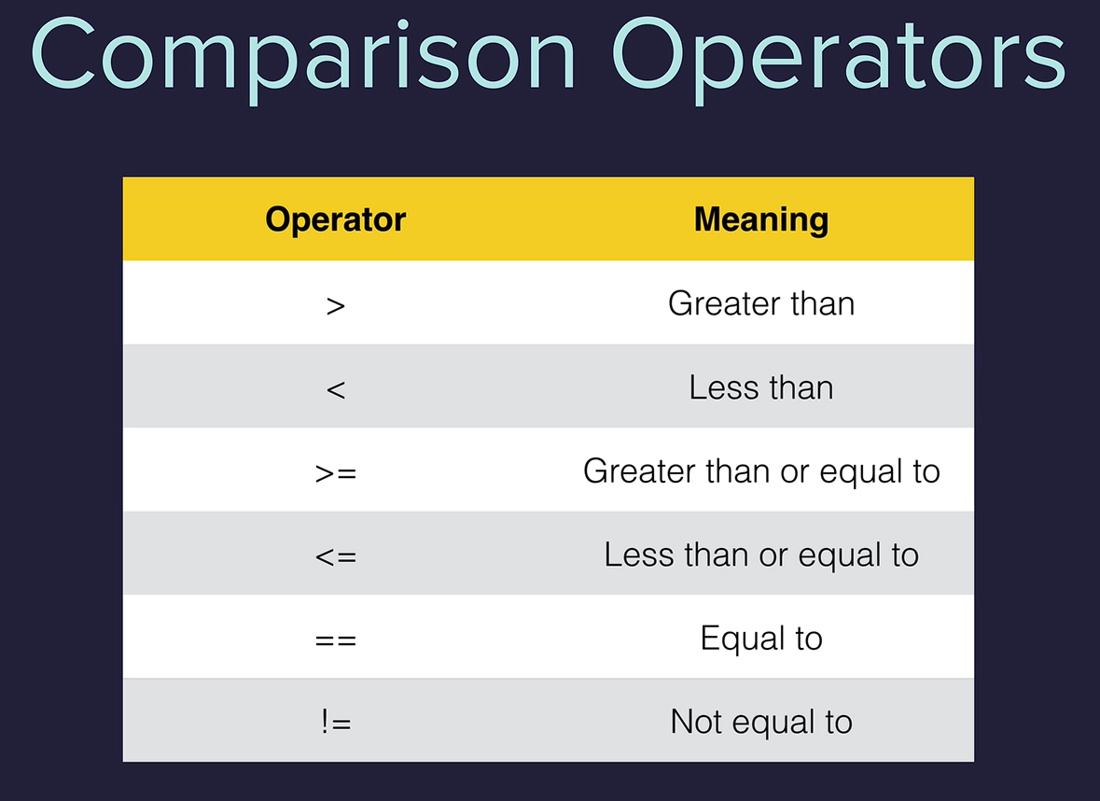

Slide 37
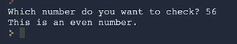
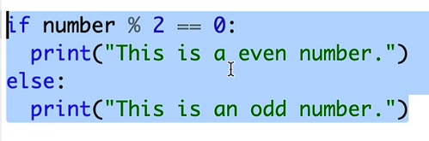

Slide 38
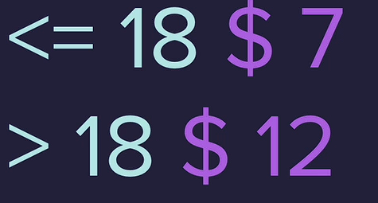
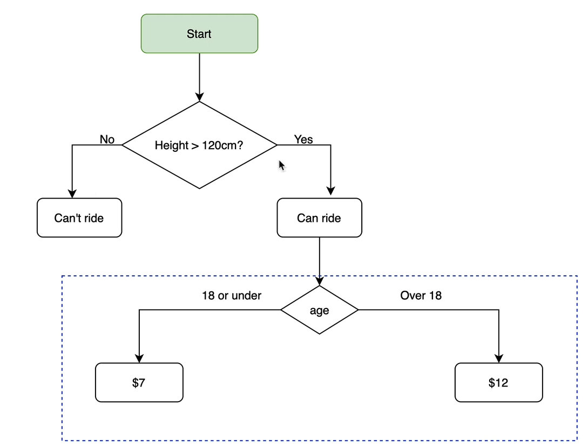
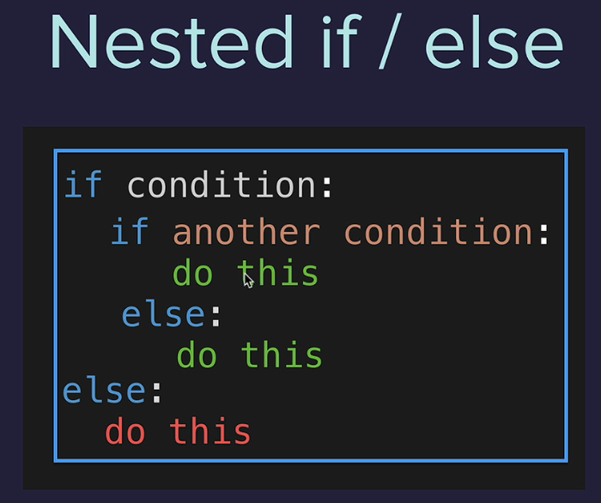
Nested if-else

Slide 39
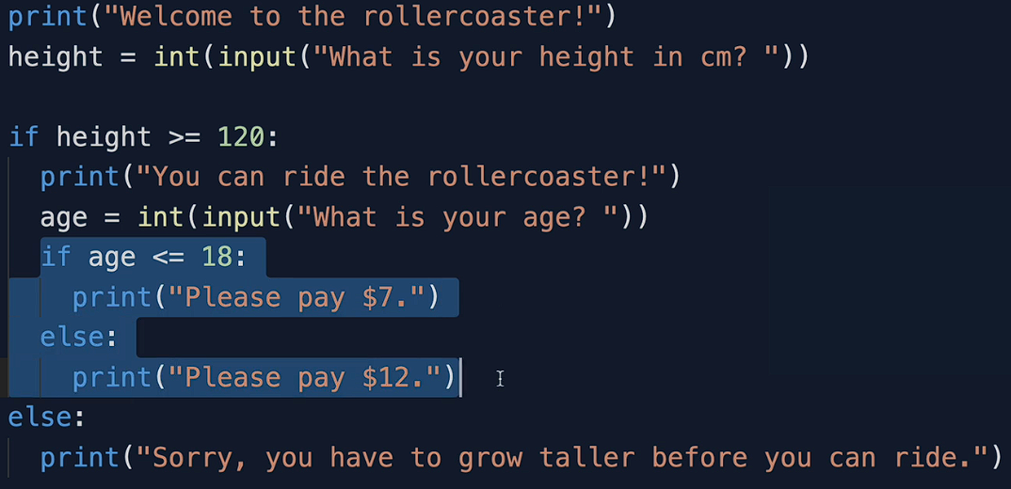
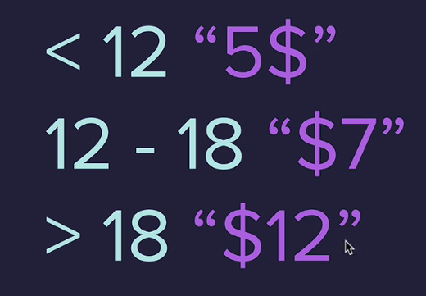
solution

Slide 40
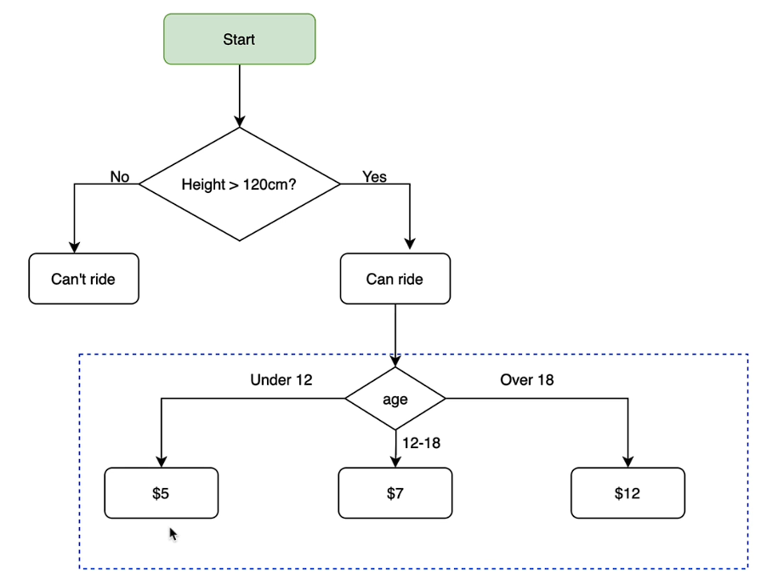
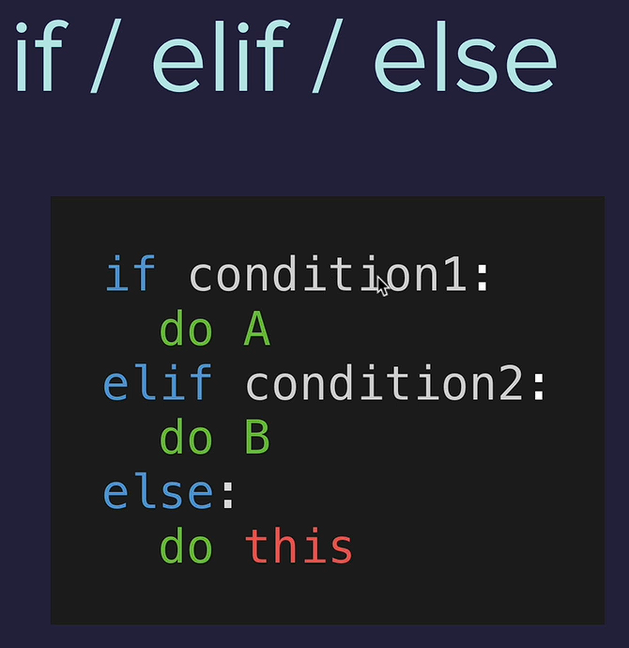

Slide 41
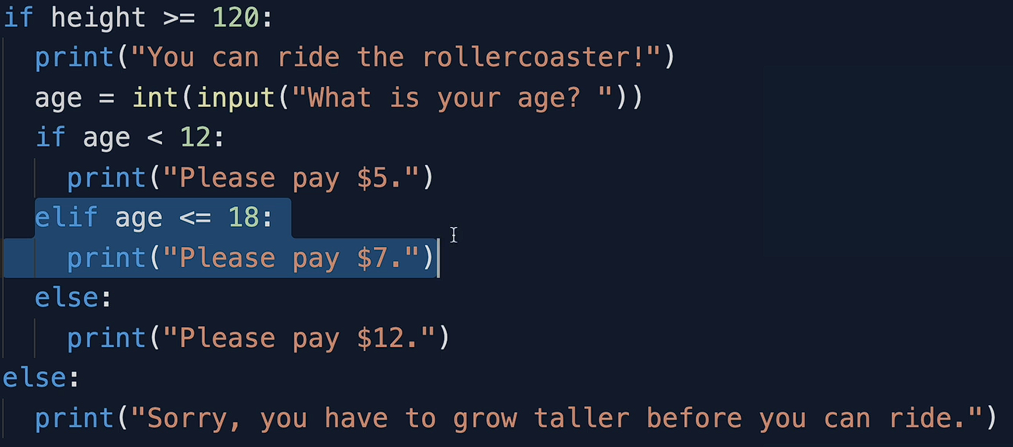
Solution

Slide 42
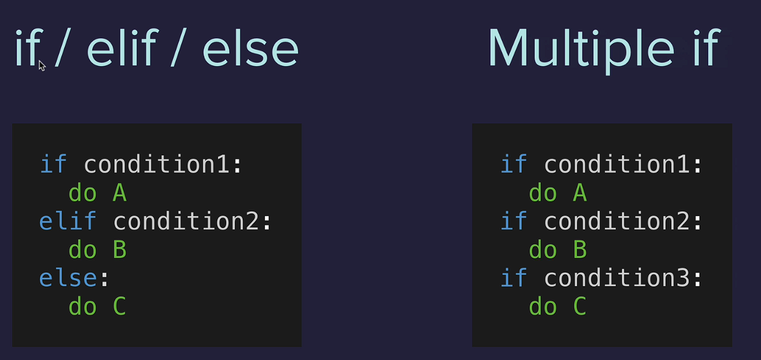
Multiple if conditions

Slide 43
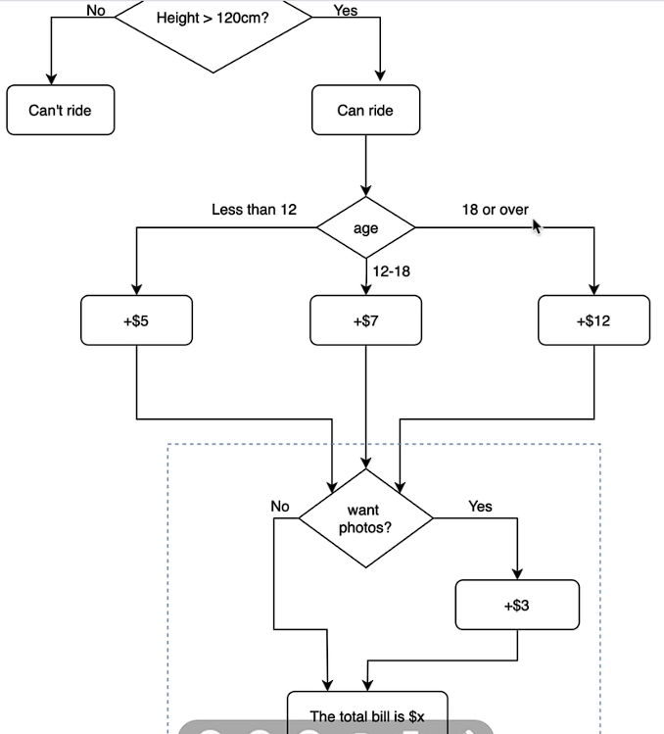
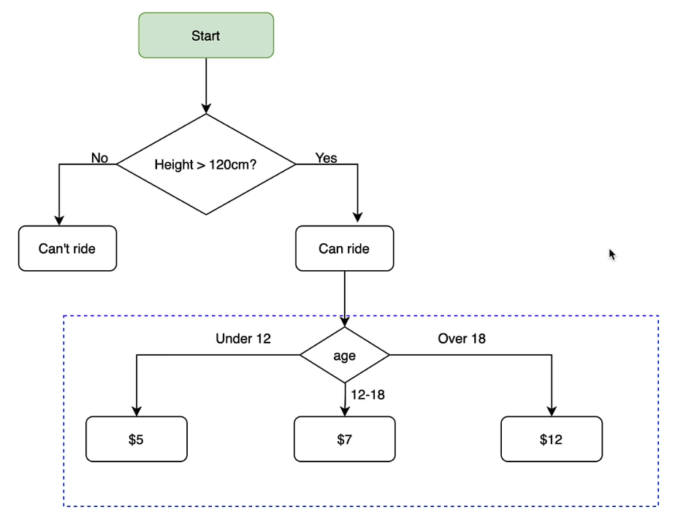
Task (Ticket pricing)

Slide 44
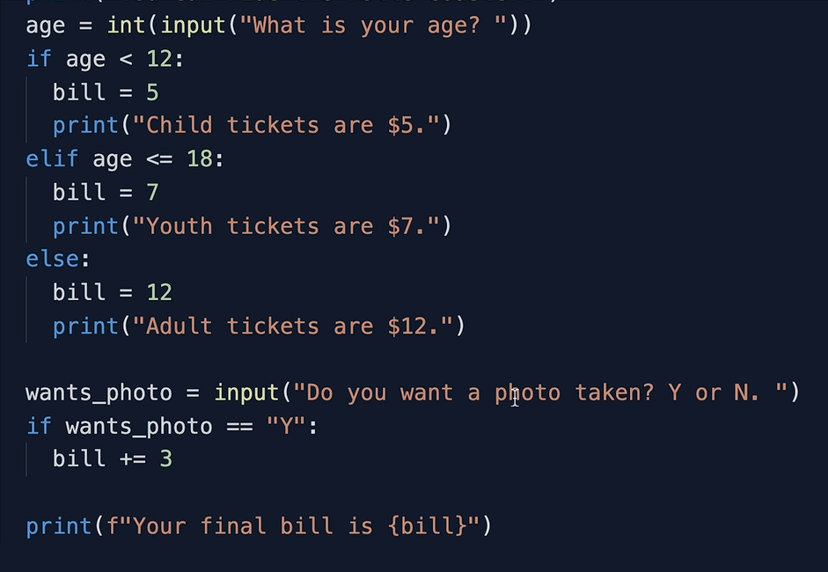
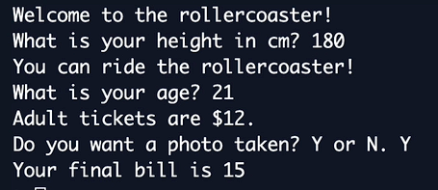
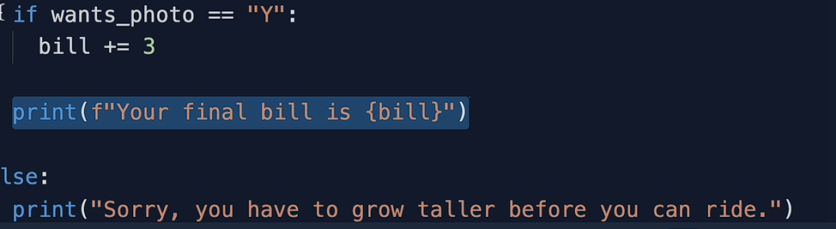
Solution / output

Slide 45

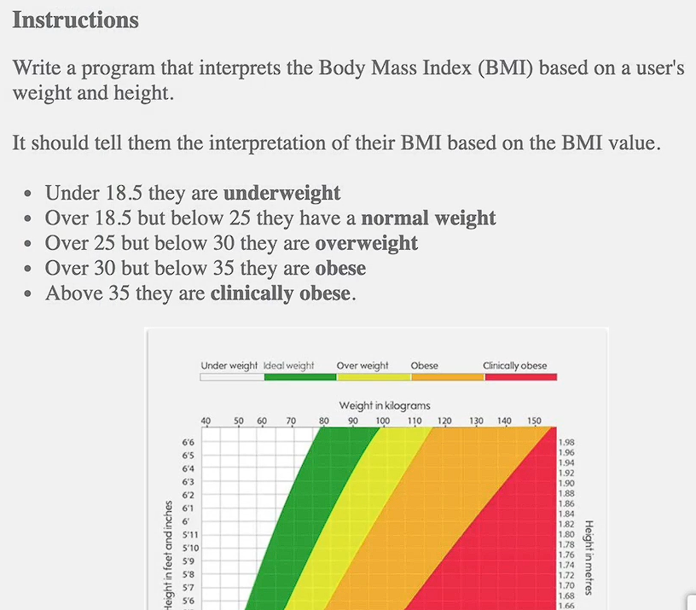
Task

Slide 46

Solution
(observe the seps flow using – thonny site)

Slide 47




Difficult Task

Slide 48


solution

Slide 49


Slide 50


solution

Slide 51



Logical Operators

Slide 52

Task

Slide 53



Slide 54



Hint & output

Slide 55


Solution

Slide 56


Day – 3 Project

Slide 57

Algorithm ( flow-chart)

Slide 58


Solution

Slide 59


Slide 60

Random numbers (import random)

Slide 61

Task

Slide 62

Data structures
Lists

Slide 63

String method

Slide 64

Nested lists

Slide 65



Day – 4 Project

Slide 66


Solution

Slide 67


Coding == gym

Slide 68


Slide 69



Slide 70


Solution

Slide 71

Actual way of writing solution

Slide 72


Slide 73



Slide 74

Solution ( 2 methos )
Method 1
Method2

Slide 75


Slide 76




Slide 77

solution

Slide 78


Project 5 – (Password generator)

Slide 79



Hint

Slide 80



solution

